Slide 1


Climate Change and the Health of People with Existing Medical Conditions

Slide 2
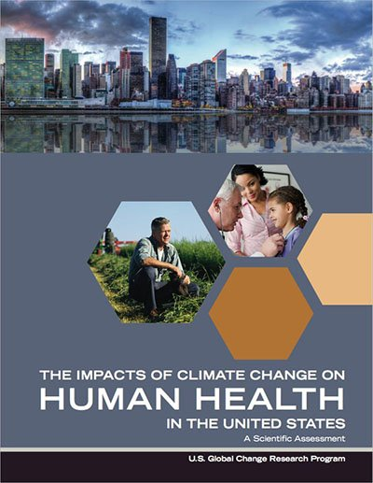
The US Climate Health Assessment
    What is it?
  An assessment of the risks climate change poses to human health in the United States
  An Interagency product of the US Global Change Research Program (USGCRP)
  Part of the ongoing National Climate Assessment (NCA) process
    Who wrote it?
  A team of ~100 Federal employees, contractors, and grantees from eight U.S. Federal agencies: HHS (NIH, CDC, NIOSH, ASPR, FDA, SAMHSA), NOAA, EPA, USDA, NASA, USGS, DOD (USUHS), VA.
Health2016.globalchange.gov
  “Climate change is a significant threat to the health of the American people.”
Notes:
All of the information in this power point is taken from this Assessment
Where does the information in the assessment come from?
The assessment information comes from the peer-reviewed scientific literature, and the report itself was also peer-reviewed.
What is the geographic and timescale focus?
The assessment focuses on observed and current health impacts in the United States as well as the future projections of impacts. Where possible, the report presents quantitative estimates of future impacts for the years 2030, 2050, and 2100.
How is the assessment organized?
The report assesses the scientific literature in eight focus areas:
Temperature Related Death and Illness; Air Quality Impacts; Extreme Weather; Vectorborne Disease; Water- Related Illnesses; Food Safety, Nutrition, and Distribution; Mental Health and Well-Being; and Populations of Concern

Slide 3
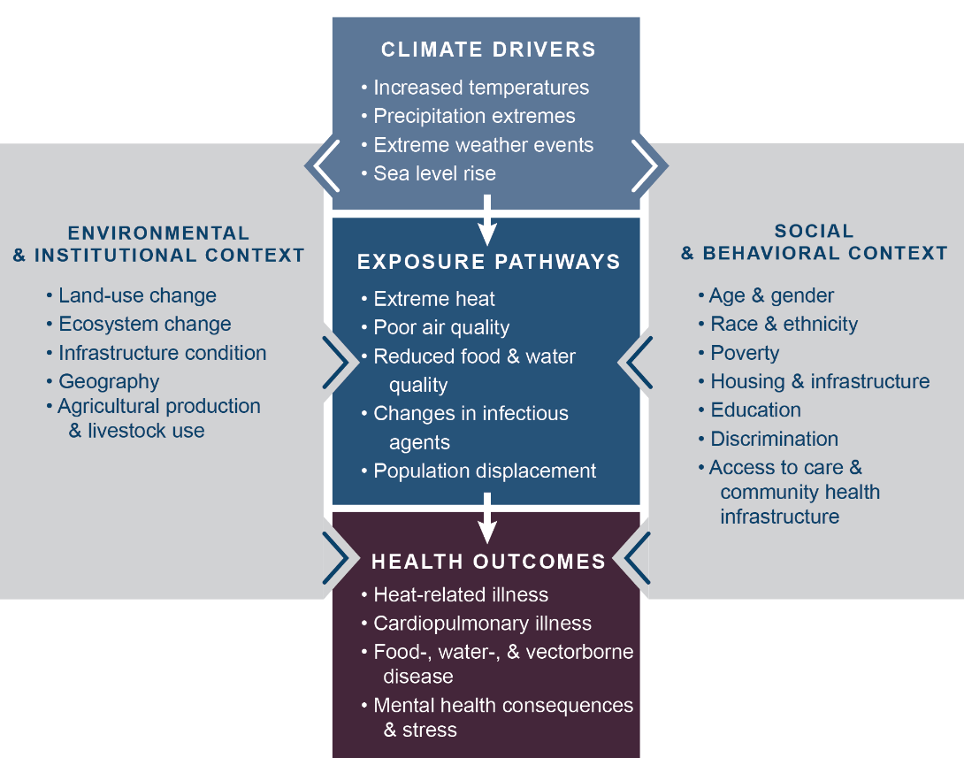
How Climate Change Can Impact Health
Notes:
This figure illustrates a pathway of how changes in Earth’s climate directly and indirectly affect human health. Examples listed in the center boxes show these key connections, such as increased temperatures due to climate change leading to more people experiencing or coming into contact with extreme heat, thus increasing the risk of heat-related illnesses.
The gray side boxes indicate other factors that can positively or negatively influence a person’s risk of exposure and health outcomes, like access to healthcare, the physical environment (buildings, infrastructure, etc.) in which that person lives, and individual factors including race, gender, and age. These factors contribute to social and environmental disparities that make some communities particularly vulnerable to the health impacts of climate change.

Slide 4
Vulnerability
Vulnerability is the tendency or predisposition
to be adversely affected by climate-related health effects, and encompasses three elements:
exposure
sensitivity or susceptibility to harm
the capacity to adapt to or respond to a climate change threat.
While all Americans are affected by climate change, some groups are disproportionately vulnerable to climate health impacts.
Notes:
The assessment identifies eight populations disproportionately affected by climate change—communities with environmental justice concerns, indigenous peoples, children, pregnant women, older adults, occupational groups, people with disabilities, and people with pre-existing medical conditions.

Slide 5
Existing Medical Conditions and
Climate Change
People with existing medical conditions are at increased risk for illness and death from climate change-related impacts on health including:
  changing exposures to extreme heat
  extreme weather events
  poor air quality
Existing medical conditions can make individuals more sensitive to these exposures, increasing the potential for health impacts and worsening symptoms.

Slide 6
Common Chronic Medical Conditions
People with the following illnesses should be aware that:
Heart Disease. Drugs used to treat heart diseases, such as diuretics and beta-blockers, can make people with heart disease more sensitive to heat stress.
Diabetes. Diabetes increases sensitivity to heat stress. Extreme weather events can also present challenges for diabetics because these events can limit access to healthcare, medicine, and food needed to stay healthy.
Asthma and COPD. Patients with asthma and COPD are more sensitive than the general population to changes in outdoor air quality made worse by climate change.
Alzheimer’s Disease. Alzheimer’s disease can impair judgment and responses in a crisis situation, such as an extreme weather event, which can place people at greater risk.
Mental Illness. Some medications for certain mental illnesses can increase sensitivity to heat stress. Extreme weather events may also disrupt communication lines and social support networks that people with mental illnesses need to stay healthy.

Slide 7
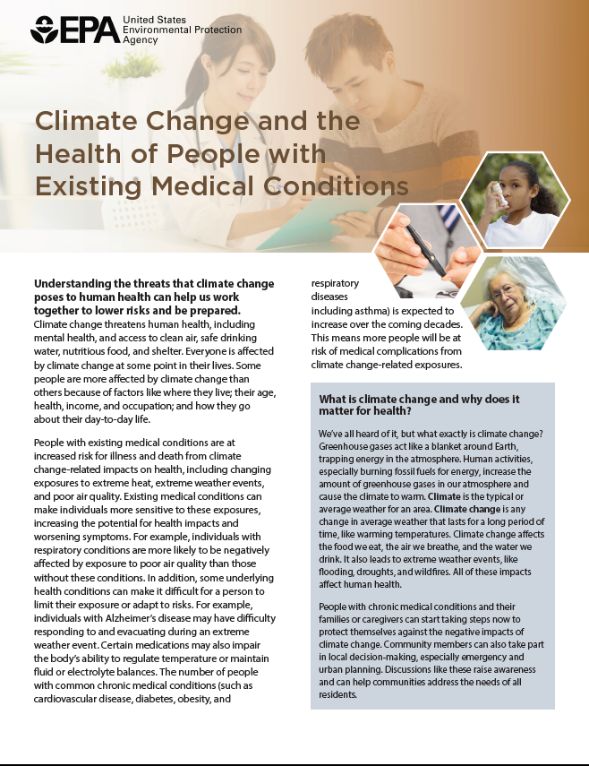
For More Information
Factsheet: Climate Change and the
Health of People with Existing Medical Conditions
www.epa.gov/climate-impacts/communicating-vulnerabilities-climate-change-existing-health-conditions
Notes:
See communications materials for other populations of concern:
www.epa.gov/climate-impacts/climate-change-health-and-populations-concern

Slide 8
Additional Resources
EPA Resources:
www.epa.gov/climate-impacts
USGCRP Climate and Health Assessment:
health2016.globalchange.gov

