Slide 1
Climate Change and the Health of Older Adults

Slide 2
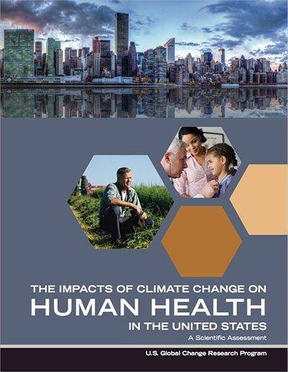
The US Climate Health Assessment
What is it?
An assessment of the risks climate change poses to human health in the United States
An Interagency product of the US Global Change Research Program (USGCRP)
Part of the ongoing National Climate Assessment (NCA) process
Who wrote it?
A team of ~100 Federal employees, contractors, and grantees from eight U.S. Federal agencies: HHS (NIH, CDC, NIOSH, ASPR, FDA, SAMHSA), NOAA, EPA, USDA, NASA, USGS, DOD (USUHS), VA.
Health2016.globalchange.gov
“Climate change is a significant threat to the health of the American people.”
Notes:
All of the information in this power point is taken from this Assessment Where does the information in the assessment come from?
The assessment information comes from the peer-reviewed scientific literature, and the report itself was also peer-reviewed.
What is the geographic and timescale focus? The assessment focuses on observed and current health impacts in the United States as well as the future projections of impacts. Where possible, the report presents quantitative estimates of future impacts for the years 2030, 2050, and 2100. How is the assessment organized?
The report assesses the scientific literature in eight focus areas:
Temperature Related Death and Illness; Air Quality Impacts; Extreme Weather; Vectorborne Disease; Water- Related Illnesses; Food Safety, Nutrition, and Distribution; Mental Health and Well-Being; and Populations of Concern

Slide 3
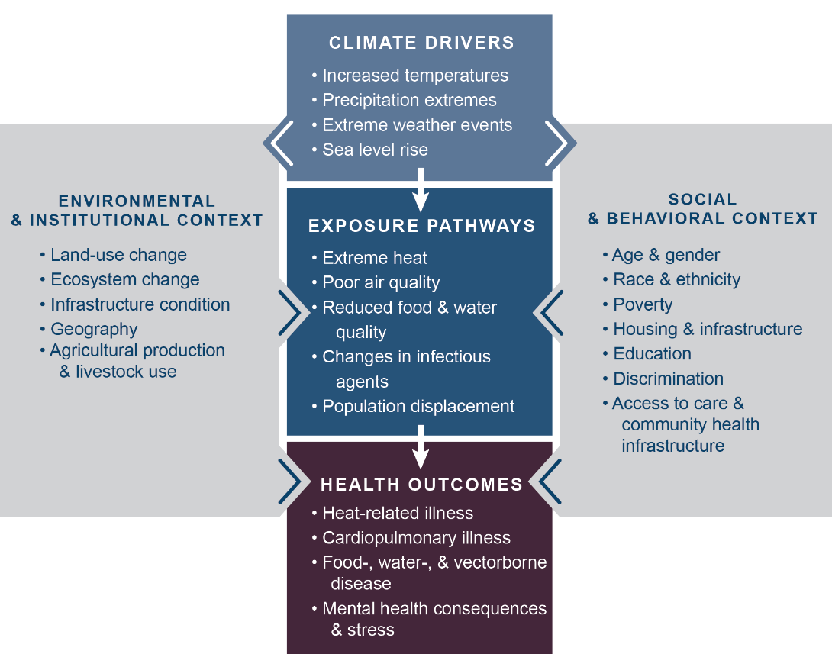
How Climate Change Can Impact Health
Notes:
This figure illustrates a pathway of how changes in Earth’s climate directly and indirectly affect human health. Examples listed in the center boxes show these key connections, such as increased temperatures due to climate change leading to more people experiencing or coming into contact with extreme heat, thus increasing the risk of heat-related illnesses. The gray side boxes indicate other factors that can positively or negatively influence a person’s risk of exposure and health outcomes, like access to healthcare, the physical environment (buildings, infrastructure, etc.) in which that person lives, and individual factors including race, gender, and age. These factors contribute to social and environmental disparities that make some communities particularly vulnerable to the health impacts of climate change.

Slide 4
Vulnerability
Vulnerability is the tendency or predisposition
to be adversely affected by climate-related health effects, and encompasses three elements:
exposure
sensitivity or susceptibility to harm
the capacity to adapt to or respond to a climate change threat.
While all Americans are affected by climate change, some groups are disproportionately vulnerable to climate health impacts.
Notes:
The assessment identifies eight populations disproportionately affected by climate change—communities with environmental justice concerns, indigenous peoples, children, pregnant women, older adults, occupational groups, people with disabilities, and people with pre-existing medical conditions.

Slide 5
Climate Change & Older Adults
Older adults are vulnerable to climate change-related health impacts for a number of reasons including:
normal changes in the body associated with aging (such as muscle and bone loss) which can limit mobility
being more likely to have a chronic health condition that requires medications or treatment
potentially needing assistance with daily activities

Slide 6
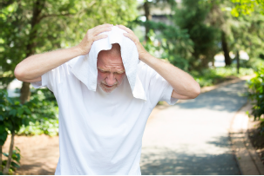
Environmental Hazards
Extreme Heat
Heat exposure can increase the risk of illness and death among older adults, especially people with chronic health conditions that increase sensitivity to heat (i.e., diabetes)
Higher temperatures have been linked to increased hospital admissions for older people with heart and lung conditions
Older adults with limited incomes may not use air conditioning units during heat waves due to the high cost of operating them

Slide 7
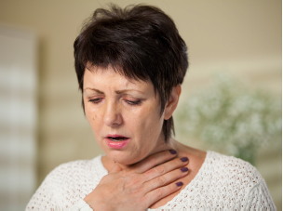
Environmental Hazards
Poor Air Quality
Poor air quality worsens respiratory conditions common in older adults, such as asthma and chronic obstructive pulmonary disease (COPD)
Air pollution can also increase the risk of heart attack in older adults, especially those who are diabetic or obese

Slide 8
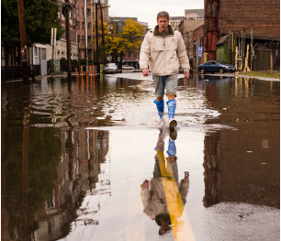
Environmental Hazards
Extreme Events
Older adults are more likely to suffer storm and flood-related fatalities
Extreme events can also cause power outages that can affect electrically-powered medical equipment and elevators, leaving some people without treatment or the ability to evacuate.

Slide 9
Environmental Hazards
Illnesses Spread By Ticks or Mosquitoes
Climate change and increased temperatures will lead to ticks and mosquitoes expanding their ranges and being present for more of the year as warmer seasons last longer.
Lyme disease, which is spread by ticks, is frequently reported in older adults
Diseases spread by mosquitoes (like West Nile and St. Louis encephalitis viruses) pose a greater health risk among older adults with already weakened immune systems

Slide 10
Environmental Hazards
Illnesses Caused by Contaminated Water
Climate change increases the contamination risk for sources of drinking water and recreational water.
Older adults are at high risk of contracting gastrointestinal illnesses from contaminated water; those already in poor health are more likely to suffer severe health consequences, including death.

Slide 11
The Impact of Location
Depending on where they live, some older adults can be more vulnerable to climate change-related health effects than others.
The increasing severity of tropical storms may pose risks for older adults living in coastal areas.
For older adults residing in cities, factors such as the urban heat island effect and urban sprawl, and neighborhood safety may also present risks.
For older adults and people with limited mobility who reside in multi-story buildings with elevators, the loss of electricity during a storm can make it difficult to get food, medicine, and other needed services.

Slide 12
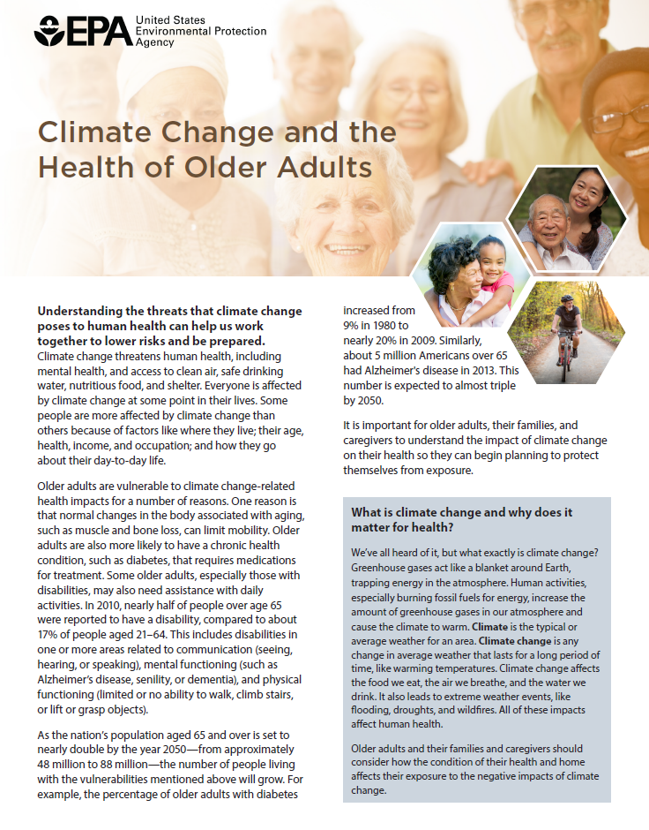
For More Information
Factsheet: Climate Change and the
Health of Older Adults
www.epa.gov/climate-impacts/communicating-vulnerabilities-climate-change-older-adults
Notes:
See communications materials for other populations of concern:
www.epa.gov/climate-impacts/climate-change-health-and-populations-concern

Slide 13
Additional Resources
EPA Resources:
www.epa.gov/climate-impacts
USGCRP Climate and Health Assessment: health2016.globalchange.gov

